Slide 1
Chapter 4 Mechanism Based Neural Networks Neural Networks for unsupervised problems

Slide 2
Mechanism Based Neural Networks Neural Networks for unsupervised problems
1- Classification/Regression Supervised Learning
2- Pattern Association Supervised Learning
3- Applications without target patterns (Unsupervised Learning)
1 - Pattern Sorting (Hard/Soft) Maximum to minimum sorting/…
2 - Pattern Clustering (Hard/Soft) data space partitioning (Similarity/Distance/….)
3 - Pattern Generation Image Enhancement / Recommender Systems/ Fashion Design / Image Painting / Image Description/Text to Image…
4 - Control tasks Anti Oscillation/Optimal control /Loop shaping /….
5 - …

Slide 3
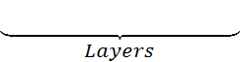
“Two Common Design Approaches in NNs”
1- Layer-Based Design (For supervised Problems)
Partitioning layers (MLP-MAdaline-….)
Mapping layers (MLP-…)
Encoding Layers (Auto-Encoder/RBM…)
Decoding layers (Auto-Encoder/RBM...)
Convolutional layers (CNN)
Pooling/Subsampling layers (CNN)
Recurrent Layers (RNN-LSTM-GRU…)
Softmax/normalizing (CNN-…)
Input patterns
Explicit or Implicit
Target outputs
Labels-Patterns
Loss Function
Error Back Propagation

Slide 4
2-Mechnism-Based Design (For Unsupervised Problems)
Learning Strategies
(a variant parallel search)
Competitive based Learning
Cooperative based Learning
Adversarial based Learning
….
Features Which Should be Satisfied in Solutions
Some Geometric features
(or) Statistical features
(or) Stability/Performance features
Within or between Distances–Similarity indices –Distribution: Propagation-Density-...surrounding-

Slide 5
Fixed –Weight Competitive Nets
MaxNet
A learning mechanism to determine the absolute largest node
Mexican Hat
A learning mechanism to determine soft largest node
Hamming Net
A learning mechanism to assign vectors to a certain number of vectors

Slide 6
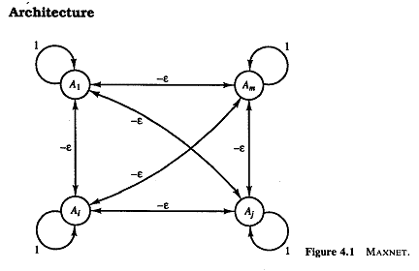
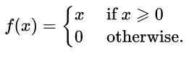
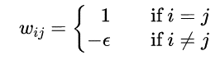
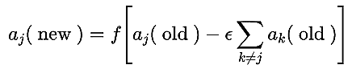
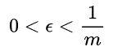
MaxNet Lippmann 1987 (competitive mechanism)
Aim: there are m>1 nodes, it is desired to pick the node which is the largest.
Recurrent Structure
Activation Function
Weights/threshold
Updating Rule

Slide 7
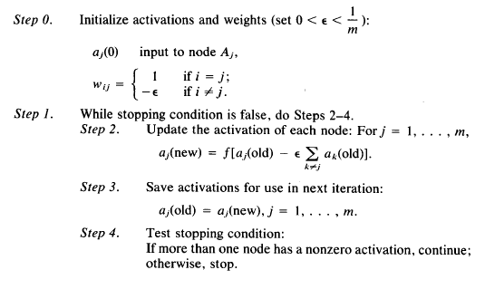
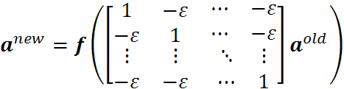
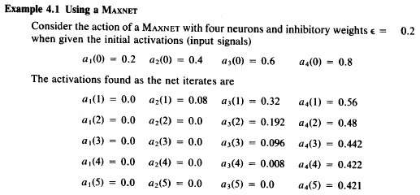
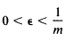
MaxNet Algorithm/Example
Nonlinear Difference Equation
Why ?
If the threshold is chosen so small …
If the threshold is chosen so the maximum .....
If some nodes are equal .....

Slide 8
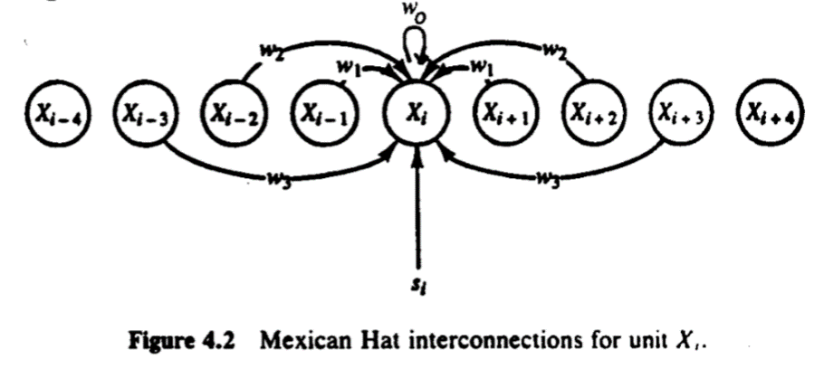
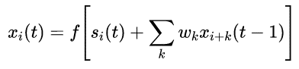
Mexican Hat Kohonen 1989 (competitive/cooperative mechanism)
Aim: there are m>1 arranged nodes, it is desired to pick the node which makes a soft maximum node, with some near adjacent nodes.
For each node Xi there are:
some nearer nodes: X_{j} ,jЄ{ i-R₁ …i+ R₁} which are wired with positive weights (cooperative nodes).
Some farer nodes: X_{j} ,jЄ{ i-R₂ …i-R₁+1}U{ i+R₁+1,….i+R₂} wired with negative weights (competitive nodes )
other nodes which are out of cooperative or competitive nodes : X_{j} , jЄ{….,i-R₂-1}U{i+R₂+1,…},
they do not wired to Xi (zero weight) .

Slide 9
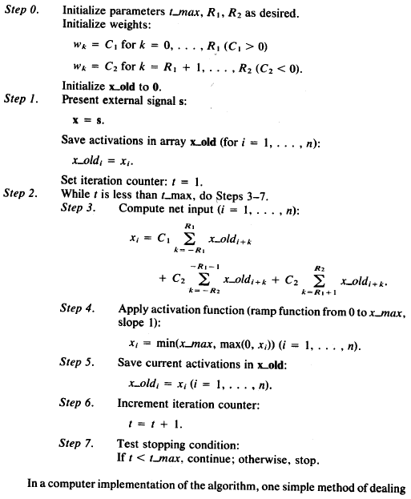
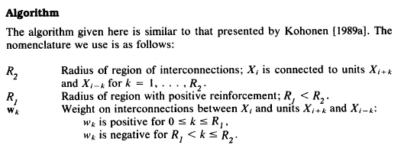
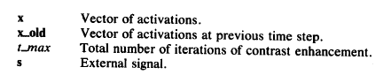

Slide 10
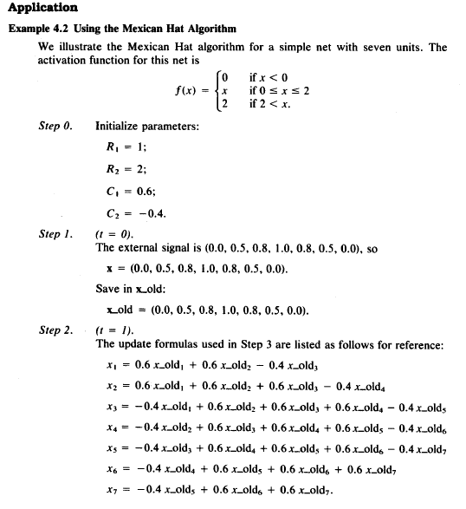
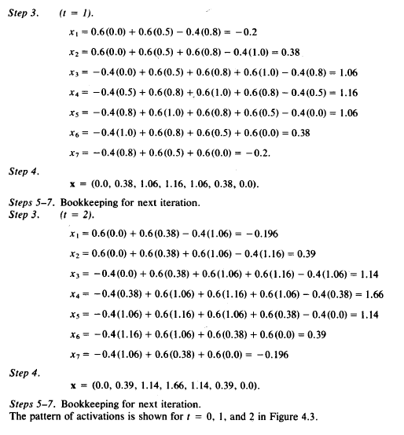

Slide 11
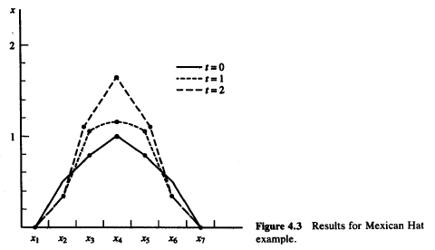

Slide 12
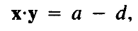
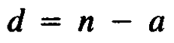
Hamming Net LippMann1987 (competitive mechanism)
There are some bipolar reference vectors. Using hamming distance index, every input vector assigns to a reference vector with minimum hamming distance.
For bipolar vectors x and y with n dimension.
a= number of equal bits
d= number of not equal bits
Also, it is known

Slide 13
Then we have:
Assuming the weight vector as w=y/2 and the bias as b=n/2, we can make a mechanism to determine the similarity of x and y.
One can say that:
“the output of the above network shows the similarity of each exogenous x to y”
x1
w1
x
x2
w2
y
a
wn
xn
b
1

Slide 14
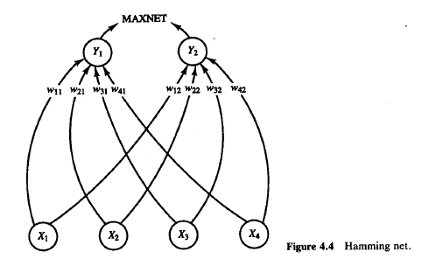
Assuming there are two n-dimensional references vectors y1 and y2
In Following network :
In the first layer, the similarity of x to references vectors: y₁=e(1) and y₂=e(2), is computed.
In the second layer, a MAXNET determines that which of two nodes has maximum value or which reference vectors (e(1) or e(2)) is more similar to x.

Slide 15
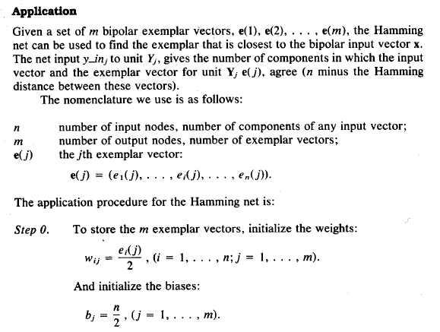
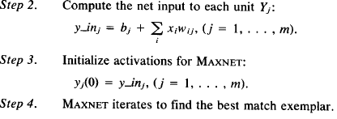
Hamming Net For m reference vector
MAXNET
Y₁
Y₂
Y_{m}
x₁
x₂
x_{n}
1
x

Slide 16
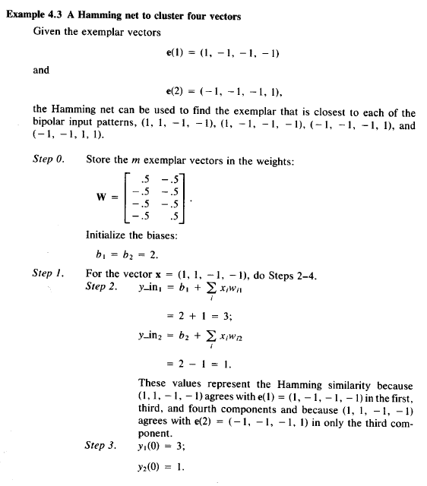
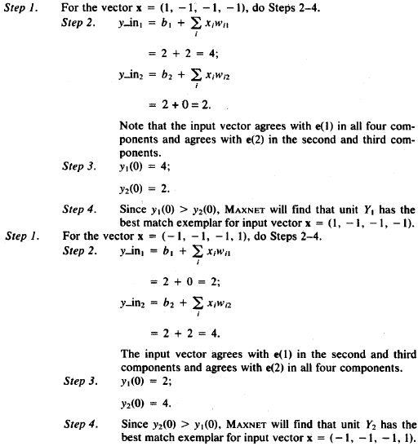

Slide 17
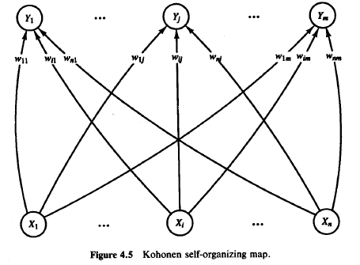
Self Organizing Map (SOM) Kohonen 1989
It is aimed to :
“divide all input n-dimensional patterns to m different clusters “
“Some of m clusters may be created as null sets“
Desired Solution:
clusters should have small within distances and large between distances

Slide 18
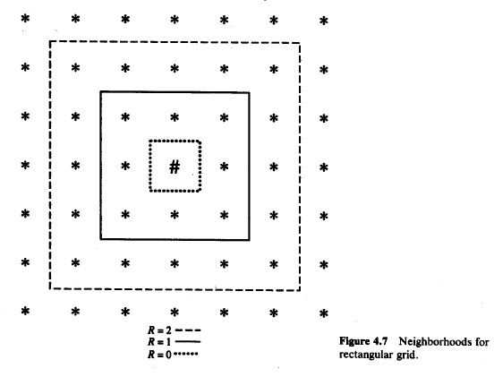
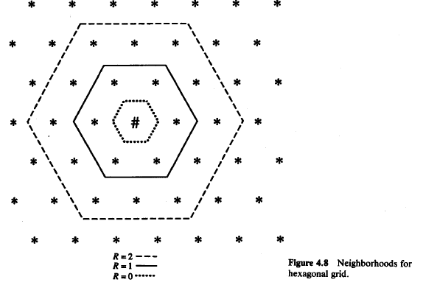
ِIN "SOM” Each Neuron represents a cluster Each neuron has a form of Neighborhoods

Slide 19
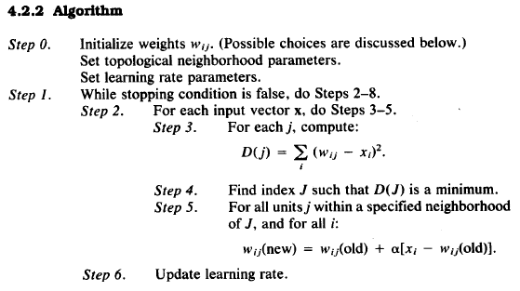
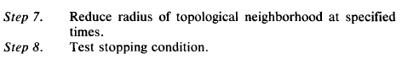
SOM Algorithm

Slide 20
Some Notes about SOM Algorithm
α as learning rate can be slowly reduced linearly or geometrically (step 6).
The Initial considered large learning rate α causes that nodes soon get randomly values among the data points.
The updating rule is the same gradient of squared error. The algorithm acts similar to k-mean clustering.
The initial considered neighborhood radius cause some nodes make a cooperation to find a cluster in a certain area.
By gradually decreasing the neighborhood radius the cooperative between near nodes is vanished and they start to compete with each other.

Slide 21
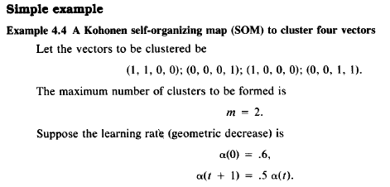
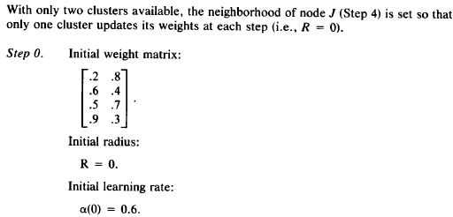
Two Examples

Slide 22
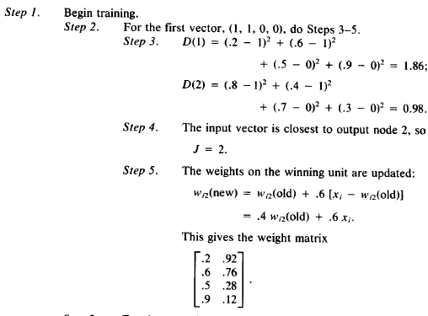
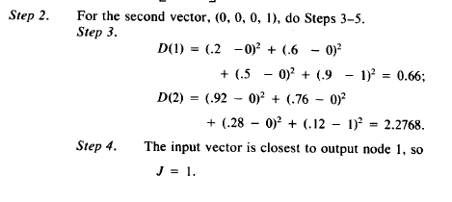
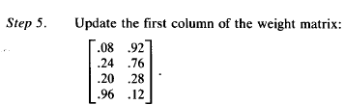

Slide 23
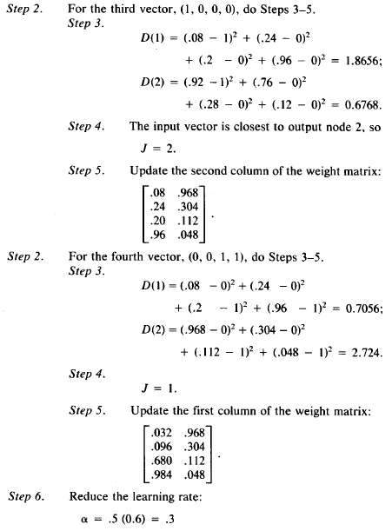

Slide 24
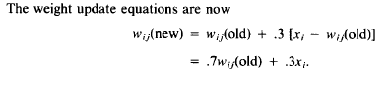
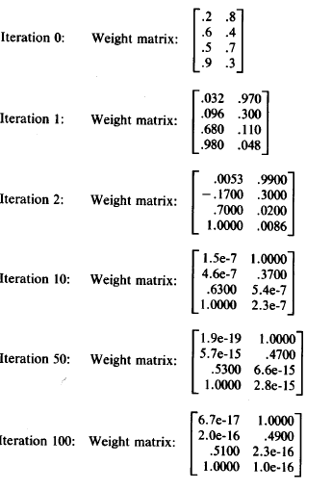
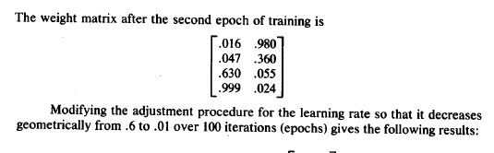
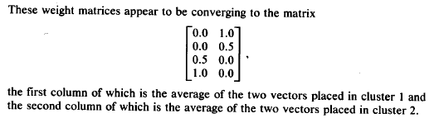

Slide 25
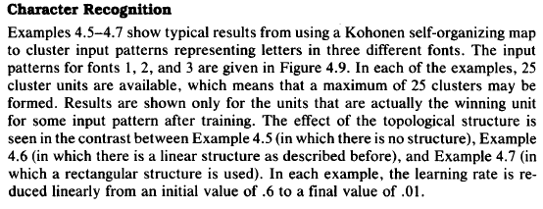
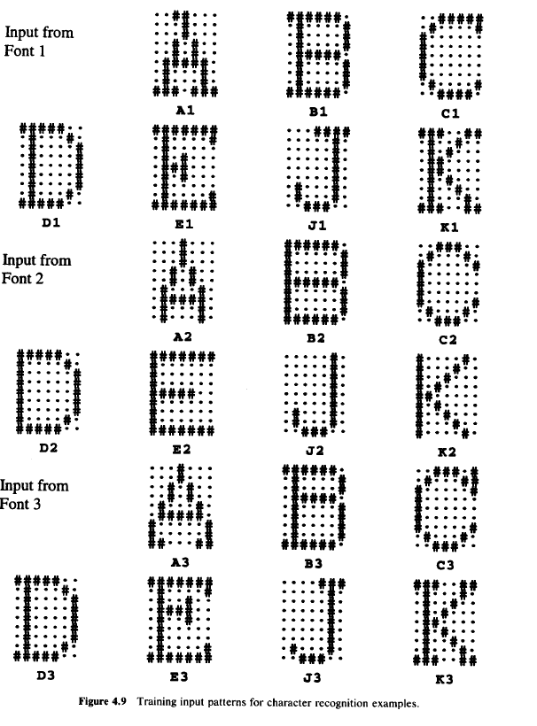

Slide 26
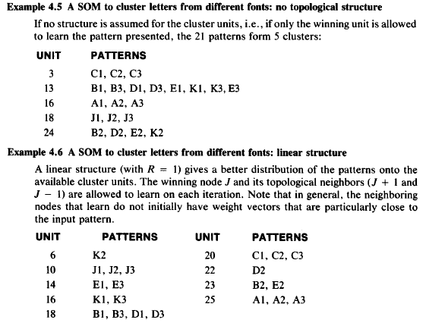

Slide 27
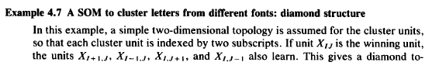
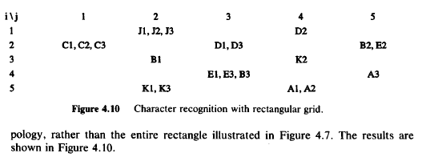

Slide 28
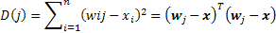
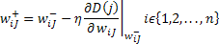
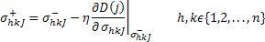
Extensions of SOM For different cluster shapes
Standard SOM (hyper circle clusters) k means/subtractive
Extended SOM (hyper ellipse clusters) G. K. / G. G.

Slide 29
Extensions of SOM For Fuzzy version
Adjacent Radius
Cooperative neurons (Hard)
J
Soft Adjacent Radius
Cooperative neurons (Soft)
J
More Computational load
With better accuracy in clustering

Slide 30
Other mechanism for clustering
LVQ1,2: Learning Vector Quantization (Kohonen,.. 1989,90)
Some supervised learning mechanisms for classification purposes, based on distance concept
Counter-propagation Network (Hecht-Nielson 1987,88)
Some mechanisms to compress data.
ART: Adaptive Resonance Theory (Capenter-Grossberg 1987)
Some mechanisms to cluster data based on weighted distance concept .

Slide 31
Generative Adversarial Network (GAN) Introductory guide to Generative Adversarial Networks (GANs) and their promise! Faizan Shaikh, June 15, 2017
Introduction
Neural Networks have made great progress.
They now recognize images and voice at levels comparable to humans.
They are also able to understand natural language with a good accuracy.
Let us see a few examples where we need human creativity (at least as of now):
Train an artificial author which can write an article and explain data science concepts to a community in a very simplistic manner by learning from past articles on Analytics Vidhya.
You are not able to buy a painting from a famous painter which might be too expensive. Can you create an artificial painter which can paint like any famous artist by learning from his / her past collections?

Slide 32
GANs: A mechanism to generate the desired patterns.
It seems we should develop a mechanism in order to generate fake patterns which are so similar to real patterns.
Ian Goodfellow (in 2014) introduce GANs for such purposes.
Yann LeCun, a prominent figure in Deep Learning Domain said in his Quora session that:
“(GANs), and the variations that are now being proposed is the most interesting idea in the last 10 years in ML, in my opinion.”

Slide 33
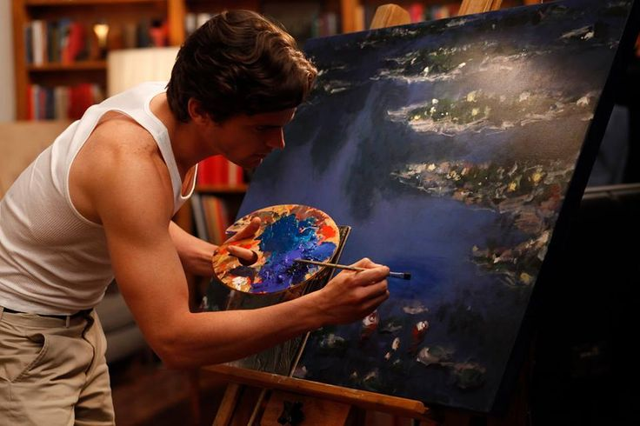
But what is a GAN?
Let us take an analogy to explain the concept:
If you want to get better at something, say chess; what would you do? You would compete with an opponent better than you. Then you would analyze what you did wrong, what he / she did right, and think on what could you do to beat him / her in the next game.
You would repeat this step until you defeat the opponent. This concept can be incorporated to build better models. So simply, for getting a powerful hero (viz generator), we need a more powerful opponent (viz discriminator)!
Another analogy from real life
A slightly more real analogy can be considered as a relation between forger and an investigator.
The task of a forger is to create fraudulent imitations of original paintings by famous artists. If this created piece can pass as the original one, the forger gets a lot of money in exchange of the piece.
On the other hand, an art investigator’s task is to catch these forgers who create the fraudulent pieces. How does he do it? He knows what are the properties which sets the original artist apart and what kind of painting he should have created. He evaluates this knowledge with the piece in hand to check if it is real or not.
This contest of forger vs investigator goes on, which ultimately makes world class investigators (and unfortunately world class forger); a battle between good and evil.

Slide 34
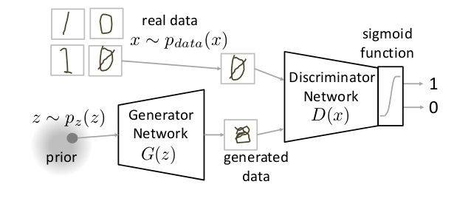
How do GANs work?
As we saw, there are two main components of a GAN – Generator Neural Network and Discriminator Neural Network.
Notes:
میتوان گفت ما از نویز سفید که برای تولیذ الگوهای نزدیک به الگوهای واقعی با تنوع بالا و درصد پوشش بالا استفاده میکنیم.
به لحاظ خاصیت هندسی ورودی های متفاوت نبایست روی یک ابر سطح خطی و یا غیرخطی با ابعاد کمتر از بعد اصلی قرار گیرند باید با شانس یکسان فضا را بپوشانند : ماکزیمم واریانس. عدد وضعیت ماتریس کواریانس فضای اولیه نباید عدد بزرگی شود.

Slide 35
About the above Figure:
The Generator Network takes an random input and tries to generate a sample of data.
In the above image, we can see that generator G(z) takes a input z from p(z), where z is a sample from probability distribution p(z).
2. It then generates a data which is then fed into a discriminator network D(x).
The task of Discriminator Network is to take input either from the real data or from the generator and try to predict whether the input is real or generated.
It takes an input x from p_{data}(x) where p_{data}(x) is our real data distribution. D(x) then solves a binary classification problem using sigmoid function giving output in the range 0 to 1.
Let us define the notations we will be using to formalize our GAN,
Pdata(x) -> the distribution of real data X -> sample from pdata(x) P(z) -> distribution of generator Z -> sample from p(z) G(z) -> Generator Network D(x) -> Discriminator Network

Slide 36

Now the training of GAN is done (as we saw above) as a
“fight between generator and discriminator.”
This can be represented mathematically as:
In our function V(D, G) the first term is entropy that the data from real distribution
(pdata(x)) passes through the discriminator (also known as (aka) best case scenario).
The discriminator tries to maximize this to 1.
The second term is entropy that the data from random input (p(z)) passes through the
generator, which then generates a fake sample which is then passed through the
discriminator to identify the fakeness (aka worst case scenario).
In this term, discriminator tries to maximize it to 0
(i.e. the log probability that the data from generated is fake is equal to 0).
of training a GAN is taken from game theory called the minimax game.

Slide 37
So overall, the discriminator is trying to maximize our function V.
On the other hand, the task of generator is exactly opposite,
i.e. it tries to minimize the function V so that the differentiation between real and fake data is bare minimum.
This, in other words is a cat and mouse game between generator and discriminator!
Note: This method of training a GAN is taken from game theory called the minimax game.

Slide 38

Pass 1: Train discriminator and freeze generator (freezing means setting training as false. The network does only forward pass and no backpropagation is applied).
G(z)

Slide 39

Pass 2: Train generator and freeze discriminator.
G(z)

Slide 40
Steps to train a GAN
Step 1: Define the problem. Do you want to generate fake images or fake text. Here you should completely define the problem and collect data for it.
Step 2: Define architecture of GAN. Define how your GAN should look like. Should both your generator and discriminator be multi layer perceptrons, or convolutional neural networks? This step will depend on what problem you are trying to solve.
Step 3: Train Discriminator on real data for n epochs. Get the data you want to generate fake on and train the discriminator to correctly predict them as real. Here value n can be any natural number between 1 and infinity.
Step 4: Generate fake inputs for generator and train discriminator on fake data. Get generated data and let the discriminator correctly predict them as fake.
Step 5: Train generator with the output of discriminator. Now when the discriminator is trained, you can get its predictions and use it as an objective for training the generator. Train the generator to fool the discriminator.
Steps to train a GAN
Step 6: Repeat step 3 to step 5 for a few epochs.
Step 7: Check if the fake data manually if it seems legit. If it seems appropriate, stop training, else go to step 3. This is a bit of a manual task, as hand evaluating the data is the best way to check the fakeness. When this step is over, you can evaluate whether the GAN is performing well enough.

Slide 41

A pseudocode of GAN training can be thought out as follows

Slide 42



We will try to generate digits by training a GAN
After training for 100 epochs, I got the following generated images

Slide 43


Applications of GAN
Predicting the next frame in a video : You train a GAN on video sequences and let it predict what would occur next
Notes:
تصویر اول و بعدی متناسب را d از تصویر اول و ساخته شده جدا می کند. و حالا باید g سعی کند تصویر بعدی را درست حدس بزند. به نظر ارتباط هر دو تصویر متوالی میتواند یک ویژگیهای خاصی داشته باشد که g باید آن را یاد بگیرد.

Slide 44

Increasing Resolution of an image : Generate a high resolution photo from a comparatively low resolution.
Previous Attempts
SRGAN

Slide 45

Image to Image Translation : Generate an image from another image. For example, given on the left, you have labels of a street scene and you can generate a real looking photo with GAN. On the right, you give a simple drawing of a handbag and you get a real looking drawing of a handbag.

Slide 46

Text to Image Generation : Just say to your GAN what you want to see and get a realistic photo of the target.

Slide 47

Interactive Image Generation(IGAN) : Draw simple strokes and let the GAN draw an impressive picture for you

Slide 48
A General Plan to generate solutions for challenging problems
Problem
Px
Discriminator
x
Problems and solutions
(1,0)
Solution
Generator
G(Cond, z)
Problem
Problem as condition
Cond.
z
Solution
Pz (noise) z

Slide 49

Challenges With GAN Problem with Counting: GANs fail to differentiate how many of a particular object should occur at a location. As we can see below, it gives more number of eyes in the head than naturally present.

Slide 50

GANs fail to adapt to 3D objects. It doesn’t understand perspective, i.e.difference between frontview and backview. As we can see below, it gives flat (2D)

Slide 51

Problems with Global Structures Same as the problem with perspective, GANs do not understand a holistic structure. For example, in the bottom left image, it gives a generated image of a quadruple cow, i.e. a cow standing on its hind legs and simultaneously on all four legs. That is definitely not possible in real life!

Slide 52
Some Extensions on GANs
Bidirectional GAN Context-Conditional GAN Context Encoder Coupled GANs CycleGAN DualGAN LSGAN Pix2Pix PixelDA Wasserstein GAN GP Adversarial Autoencoder | DCGANs BGAN SRGAN CGAN Auxiliary Classifier GAN Semi-Supervised GAN StackGAN Disco GANS Flow based GANs InfoGANs Wasserstein GAN

Slide 53

(1) Deep Convolutional GANs (DCGANs) https://arxiv.org/abs/1710.10196 (Jan 2016)
In this article, we will see how a neural net maps from random noise to an image matrix and how using Convolutional Layers in the generator network produces better results.
Original DCGAN architecture(Unsupervised Representation Learning with Deep Convolutional Generative Adversarial Networks) have four convolutional layers for the Discriminator and four “four fractionally-strided convolutions” layers for the Generator.
Notes:
در کانلوشن با stride ”1“ عکس با ابعاد a*b با پنجره c*d به عکس a-c*b-d (B) تبدیل میشود (البته با padding ابعاد عوض نمی شود) و با stride بیش از ”1“ابعاد کمتر خواهد شد ولی با stride زیر 1 مثلا 1/n (و با وجود paddding) ابعاد حدود (a*n)*(b*n) می شود.

Slide 54

(DCGAN) Generator
This network takes in a 100x1 noise vector, denoted z, and maps it into the G(Z) output which is 64x64x3.
This architecture is especially interesting the way the first layer expands the random noise. The network goes from 100x1 to 1024x4x4! This layer is denoted ‘project and reshape’. We see that following this layer, classical convolutional layers are applied. In the diagram above we can see that the N parameter, (Height/Width), goes from 4 to 8 to 16 to 32, it doesn’t appear that there is any padding, the kernel filter parameter F is 5x5, and the stride is 2. You may find this equation to be useful for designing your own convolutional layers for customized output sizes.
we see the network goes from
100x1 → 1024x4x4 → 512x8x8 → 256x16x16 → 128x32x32 → 64x64x3
Notes:
در کانلوشن با stride 1 ابعاد عکس کانوالو شده تقریبا ثابت می شود با stride بیش از 1 مثلا 2 ابعاد تقریبا نصف می شود ولی با stride کسر کوچکتر از 1 مثلا 0.5 ابعاد تقریبا دو برابر می شود.....

Slide 55

Above is the output from the network presented in the paper, citing that this came after 5 epochs of training. Pretty impressive stuff.

Slide 56
(2) Boundary-Seeking Generative Adversarial Networks(BGAN) https://arxiv.org/abs/1702.08431 (2017)
We introduce a method for training GANs with discrete data that uses the estimated difference measure from the discriminator to compute importance weights for generated samples, thus providing a policy gradient for training the generator.
The importance weights have a strong connection to the decision boundary of the discriminator, and we call our method boundary-seeking GANs (BGANs).
We demonstrate the effectiveness of the proposed algorithm with discrete image and character-based natural language generation.
In addition, the boundary-seeking objective extends to continuous data, which can be used to improve stability of training, and we demonstrate this on Celeba, Large-scale Scene Understanding (LSUN) bedrooms, and Imagenet without conditioning.
Notes:
گویی هر چه نمونه generator به مرز جداسازی نمونه های واقعی و فیک دورتر باشد ضریب بزرگتر و گرنه ضریب کمتر خواهد گرفت و به اینصورت سرعت یادگیری زیادتر خواهد شد. و دیگر نیازی به شرطی کردن نخواهد بود.

Slide 57

Training a GAN with different generator loss functions and 5 updates for the generator for every update of the discriminator.
Over-optimizing the generator can lead to instability and poorer results depending on the generator objective function.
Samples for GAN and GAN with the proxy loss are quite poor at 50 discriminator epochs (250 generator epochs), while BGAN is noticeably better.
At 100 epochs, these models have improved, though are still considerably behind BGAN.
Notes:
Proxy Loss:
A loss function which is much easier to optimize computationally

Slide 58

Notes:
Large-scale Scene Understanding

Slide 59


(3) Conditional GANs (cGANs)
1. These GANs use extra label information and result in better quality images and are able to control how generated images will look. cGANs learn to produce better images by exploiting the information fed to the model.
2. it does give the end-user a mechanism for controlling the Generator output
Mehdi Mirza, Simon Osindero
(Submitted on 6 Nov 2014)
Source: https://arxiv.org/pdf/1411.1784.pdf

Slide 60

The results of Conditional GANs are very impressive. They allow for much greater control over the final output from the generator
Results testing Conditional GANs on MNIST

Slide 61


AC-GAN Auxiliary Classifier GANs
By adding an auxiliary classifier to the discriminator of a GAN, the discriminator produces not only a probability distribution over sources but also probability distribution over the class labels.
Source: Augustus Odena, Christopher Olah, Jonathon Shlens. Conditional Image Synthesis with Auxiliary Classifier GANs. 2016.
The sample generated images from CIFAR-10 dataset.

Slide 62

In the AC-GAN paper, 100 different GAN models each handle 10 different classes from the ImageNet dataset consisting of 1,000 different object categories
The sample generated images from ImageNet dataset.

Slide 63

(4) Super Resolution GAN (SR GAN)
Super-resolution is a task concerned with upscaling images from low-resolution sizes such as 90 x 90, into high-resolution sizes such as 360 x 360.
Source: Photo-Realistic Single Image Super-Resolution Using a Generative Adversarial Network. Christian Ledig, Lucas Theis, Ferenc Huszar, Jose Caballero, Andrew Cunningham, Alejandro Acosta, Andrew Aitken, Alykhan Tejani, Johannes Totz, Zehan Wang, Wenzhe Shi.

Slide 64

In this example, 90 x 90 to 360 x 360 is denoted as an up-scaling factor of 4x.
These networks learn a mapping from the low-resolution patch through a series of convolutional, fully-connected, or transposed convolutional layers into the high-resolution patch.

Slide 65

For example, this network could take a 64x 64low-resolution patch, convolve over it a couple times such that the feature map is something like 16 x 16 x 512, flatten it into a vector, apply a couple of fully-connected layers, reshape it, and finally, up-sample it into a 256x 256 high-resolution patch through transposed convolutional layers.

Slide 66

(5) StackGAN
Text to Photo-realistic Image Synthesis with Stacked generative Adversarial Networks, Han Zhang, …..
The authors of this paper propose a solution to the problem of synthesizing high-quality images from text descriptions in computer vision. They propose Stacked Generative Adversarial Networks (StackGAN) to generate 256x256 photo-realistic images conditioned on text descriptions. They decompose the hard problem into more manageable sub-problems through a sketch-refinement process.
The Stage-I GAN sketches the primitive shape and colors of the object based on the given text description, yielding Stage-I low-resolution images. The Stage-II GAN takes Stage-I results and text descriptions as inputs, and generates high-resolution images with photo-realistic details.
Notes:
ظاهرا ابتدا شبکه سعی می کند با تصویر سازی با رزولیشن پایین یک تصویر بساز د و سپس یک نمونه با رزوولوشن بالا ساخته خواهد شد.
میتوان تصور کرد شبکه بصورت با سرپرست توصیفات متفاوت و متنوع مربوط به یک کلاس از اشیا را یاد می گیرد و سپس سعی می کند این توصیف را از کلمات متوجه شده و بصورت شرطی ابتدا بردار تصادفی را در هر بخش متاثر از صورتهای شرطی کند و سپس در یک مرحله تصویر با رزولوشن کم بسارد و سپس تصویر را با زرولوشن بالاتر تولید کند.

Slide 67

The architecture of the proposed StackGAN.

Slide 68

Comparison

Slide 69

Comparison

Slide 70

(6) Discover Cross-Domain Relations with GANs(Disco GANS)
The authors of this paper propose a method based on generative adversarial networks that learns to discover relations between different domains (without any extra labels). Using the discovered relations, the network transfers style from one domain to another..
Bag
D
G
Shoes
Fake Bag conditioned by shoes

Slide 71
(7) Flow-Based GANs Oct 13, 2018 by Lilian Weng
Here is a quick summary of the difference between GAN, VAE, and flow-based generative models:
Generative adversarial networks: GAN provides a smart solution to model the data generation, an unsupervised learning problem, as a supervised one. The discriminator model learns to distinguish the real data from the fake samples that are produced by the generator model. Two models are trained as they are playing a minimax game.
Variational autoencoders: VAE inexplicitly optimizes the log-likelihood of the data by maximizing the evidence lower bound (ELBO).
Flow-based generative models: A flow-based generative model is constructed by a sequence of invertible transformations. Unlike other two, the model explicitly learns the data distribution p(x) and therefore the loss function is simply the negative log-likelihood.

Slide 72

Types of Generative Models
Notes:
در روش اول مازعه بین d و g به تولید الگو ختم می شود.
در روش دوم یک عامل تصادفی کوچک در فضای انکود شده ویژگی الگوی جدید تولید می کنئ.
در روش سوم سعی می گردد تابع چگالی ویژگی الگوها تخمین زده شود و سپس با ایجاد تصادف عکس تابع آموخته شود.

Slide 73
Toward using both maximum likelihood and adversarial training
Implicit models such as generative adversarial networks (GAN) often generate better samples compared to explicit models trained by maximum likelihood.
However, we know that the method based on maximum likelihood explicitly learn the probability density function of the input data.
To bridge this gap, we propose Flow-GANs, a generative adversarial network for which we can perform Exact likelihood evaluation, thus supporting both adversarial and maximum likelihood training.
Notes:
این روش سعی می کند از هر دو مزیت روشهای ماکسییم لایکلیهود (روش بیشینه بزرگ نمایی) و روش منازعه در تولید الگو بهره ببرد.
روش اول بصراحت الگوهای تولیدی را با لحاظ مفهوم تابع چگالی احتمالاتی داده های وروذی ایجاد می کند ولی مشکل بهینه سازی در آن وجود دارد.
در حالی که روش دوم روش موفق تری در تولید الگوهای شبه واقعی دارد و لی نقطه قوت تفسیر آماری مانند روش اول را ندارد.
ترکیب این توانمندی روش ازعه و البته ملاحظه تابع هزینه بزرگ نمایی می تواند به تولید الگوهای بهتر بیانجامد.

Slide 74


Slide 75

(8) InfoGANs Interpretable Representation Learning by Information Maximizing Generative Adversarial Nets NIPS 2016
InfoGANs InfoGAN is an information-theoretic extension to the GAN that is able to learn disentangled representations in an unsupervised manner. InfoGANs are used when your dataset is very complex, when you’d like to train a cGAN and the dataset is not labelled, and when you’d like to see the most important features of your images.
Notes:
ارایه آزاد و مستقل
ظاهرا ه شیوه غیر سرپرستی و از روی تکرار ویژگی ها و تئوری اطلاعات به کلاس بندی می رسی که می توانی را آن را مبنای کلندیشن کردن تولید ویژگی هم قرار دهی
به این شیوه کنترل بیشتری روی الپوهای تولید انجام می شود. چرخش، ضخامت ، بزرگی، نوع و ....

Slide 76


Slide 77


Slide 78


Slide 79

Variational Autoencoder Irhum Shafkat, Feb 4, 2018
A Standard Variational Autoencoder

Slide 80
Variational Autoencoders (VAEs) are powerful generative models Comparable with GANs
In contrast to the more standard uses of neural networks as regressors or classifiers, Variational Autoencoders (VAEs) are powerful generative models, now having applications as diverse as from generating fake human faces, to producing purely synthetic music.
And why they’re so useful in creating your own generative text, art and even music.

Slide 81

But first, why VAEs?
When using generative models, you could simply want to generate a random, new output, that looks similar to the training data, and you can certainly do that too with VAEs.
But more often, you’d like to alter, or explore variations on data you already have, and not just in a random way either, but in a desired, specific direction. This is where VAEs work better than any other method currently available.
Like a “Conditional GAN” in an Image to Image Translation or specifically like a “InfoGan”

Slide 82


An standard autoencoder
An autoencoder network is actually a pair of two connected networks, an encoder and a decoder.
An encoder network takes in an input, and converts it into a smaller, dense representation, which the decoder network can use to convert it back to the original input.
A standard Autoencoder
An Encoder can be supposed as a CNN

Slide 83
Learning an autoencoder
The entire network is usually trained as a whole. The loss function is usually either the mean-squared error or cross-entropy between the output and the input, known as the reconstruction loss, which penalizes the network for creating outputs different from the input.
As the encoding (which is simply the output of the hidden layer in the middle) has far less units than the input, the encoder must choose to discard information. The encoder learns to preserve as much of the relevant information as possible in the limited encoding, and intelligently discard irrelevant parts. The decoder learns to take the encoding and properly reconstruct it into a full image. Together, they form an autoencoder.

Slide 84

The problem with standard autoencoders for generation
The fundamental problem with autoencoders, for generation, is that the latent space they convert their inputs to and where their encoded vectors lie, may not be continuous, or allow easy interpolation.
For example, training an autoencoder on the MNIST dataset, and visualizing the encodings from a 2D latent space reveals the formation of distinct clusters.
This makes sense, as distinct encodings for each image type makes it far easier for the decoder to decode them. This is fine if you’re just replicating the same images.
But when you’re building a generative model, you don’t want to prepare to replicate the same image you put in. You want to randomly sample from the latent space, or generate variations on an input image, from a continuous latent space.
If the space has discontinuities (eg. gaps between clusters) and you sample/generate a variation from there, the decoder will simply generate an unrealistic output, because the decoder has no idea how to deal with that region of the latent space. During training, it never saw encoded vectors coming from that region of latent space.
Notes:
latent space
فضای فشرده حاوی اطلاعات و در حقیقت فضای ویژگیهای اصلی تصاویر ورودی هستند. که در میانه شبکه اتوانکودر پدید می آید....
در حقیقت انتخاب یک نمونه ار این فضا، بدلیل طبیعیت عیرپیوسته و خوشه های جدا از هم فضا، تضمنی نمیکند که بتوانیم یک نمونه از تصویر ورودی را بدون کپی کاری و با ایجاد تعییرات قابل ملاحظه ولی از همان نوع را باز تولید کنیم.

Slide 85

Variational Autoencoders
Variational Autoencoders (VAEs) have one fundamentally unique property that separates them from vanilla autoencoders, and it is this property that makes them so useful for generative modeling: their latent spaces are, by design, continuous, allowing easy random sampling and interpolation.
It achieves this by doing something that seems rather surprising at first: making its encoder not output an encoding vector of size n, rather, outputting two vectors of size n: a vector of means, μ, and another vector of standard deviations, σ.
Notes:
در حقیقت در VAC این مشکل معمول حل شده است و می توان در فضای latent بصورت پیوسته و درونیابی شده نمونه تصادفی مشابه نمونه ووردی ساخت...
برای یک بردار انکود شده nبعدی در هر بعد یک میانگین و یک واریانس یادگرفته میشود که در حقیقت دو بردار n بعدی میانگین و واریانسخواهیم داشت....

Slide 86

They form the parameters of a vector of random variables of length n, with the i th element of μ and σ being the mean and standard deviation of the i th random variable, X i, from which we sample, to obtain the sampled encoding which we pass onward to the decoder:
Stochastically generating encoding vectors
Notes:
انگار هر بعد از بردار انکود شده با یک تویع نرمال مستقل مدل شده و حالا یک بردار نمونه تصادفی از توزیع های نرمال برایانکود شدن و تولید یک الگو استفاده میگردد.

Slide 87

This stochastic generation means, that even for the same input, while the mean and standard deviations remain the same, the actual encoding will somewhat vary on every single pass simply due to sampling.
Notes:
انتخاب نمونه تصادفی می تواند پیرامون ورودی داده شده بصورت کنترل شده قرار گیرد.

Slide 88
Intuitively, the mean vector controls where the encoding of an input should be centered around, while the standard deviation controls the “area”, how much from the mean the encoding can vary.
As encodings are generated at random from anywhere inside the “circle” (the distribution), the decoder learns that not only is a single point in latent space referring to a sample of that class, but all nearby points refer to the same as well.
This allows the decoder to not just decode single, specific encodings in the latent space (leaving the decodable latent space discontinuous), but ones that slightly vary too, as the decoder is exposed to a range of variations of the encoding of the same input during training.

Slide 89
The model is now exposed to a certain degree of local variation by varying the encoding of one sample, resulting in smooth latent spaces on a local scale, that is, for similar samples.
Ideally, we want overlap between samples that are not very similar too, in order to interpolate between classes.
However, since there are no limits on what values vectors μ and σ can take on, the encoder can learn to generate very different μ for different classes, clustering them apart, and minimize σ, making sure the encodings themselves don’t vary much for the same sample (that is, less uncertainty for the decoder).
This allows the decoder to efficiently reconstruct the training data.
Notes:
ناخودآگاه نمونه های یک کلاس میانگین و واریانسهای شبیه هم پیدا می کند..

Slide 90

What we ideally want are encodings, all of which are as close as possible to each other while still being distinct, allowing smooth interpolation, and enabling the construction of new samples.
Notes:
نمونه های هم کلاس در این نوع مدلسازی کنار هم هستند ولی در عین حال قابل تفکیک با نمونه های عیر هم کلاط

Slide 91

loss function : Kullback–Leibler divergence
In order to force this, we introduce the Kullback–Leibler divergence (KL divergence[2]) into the loss function. The KL divergence between two probability distributions simply measures how much they diverge from each other. Minimizing the KL divergence here means optimizing the probability distribution parameters (μ and σ) to closely resemble that of the target distribution.
For VAEs, the KL loss is equivalent to the sum of all the KL divergences between the component Xi~N(μi, σi²) in X, and the standard normal[3]. It’s minimized when μi = 0, σi = 1.
Notes:
علاوه بر هزیته معادل بودن ووردی و خروجی یک هزینه برای ابعدا میانی بردار انکودر شده که آنها را مستقل و سفید می کند وجود دارد.

Slide 92
Intuitively, this loss encourages the encoder to distribute all encodings (for all types of inputs, e.g. all MNIST numbers), evenly around the center of the latent space.
If it tries to “cheat” by clustering them apart into specific regions, away from the origin, it will be penalized.
Now, using purely KL loss results in a latent space results in encodings densely placed randomly, near the center of the latent space, with little regard for similarity among nearby encodings.
The decoder finds it impossible to decode anything meaningful from this space, simply because there really isn’t any meaning.

Slide 93


Optimizing the two together, however, results in the generation of a latent space which maintains the similarity of nearby encodings on the local scale via clustering, yet globally, is very densely packed near the latent space origin (compare the axes with the original).

Slide 94
Intuitively, this is the equilibrium reached by the cluster-forming nature of the reconstruction loss, and the dense packing nature of the KL loss, forming distinct clusters the decoder can decode.
This is great, as it means when randomly generating, if you sample a vector from the same prior distribution of the encoded vectors, N(0, I), the decoder will successfully decode it.
And if you’re interpolating, there are no sudden gaps between clusters, but a smooth mix of features a decoder can understand.

Slide 95


Vector arithmetic
So how do we actually produce these smooth interpolations we speak of? From here on out, it’s simple vector arithmetic in the latent space.
Interpolating between samples. For example, if you wish to generate a new sample halfway between two samples, just find the difference between their mean (μ) vectors, and add half the difference to the original, and then simply decode it.
Adding new features to samples What about generating specific features, such as generating glasses on a face? Find two samples, one with glasses, one without, obtain their encoded vectors from the encoder, and save the difference. Add this new “glasses” vector to any other face image, and decode it.
Notes:
یک نگاه و تفسیر برداری در فضای اطلاعاتی latent وجود خواهد داشت.
اگر بخواهی تصویر شی خصوصیات دو شی واقعی را داشته باشد به نوعی میتوانی درمیانگین های بردار انکود شده دو شی و با توجه به بردار واریانسهای آنها میانیابی کنی...
مثا اضافه کرد عینک به صورت. کافی است دو نمونه یکی با عینک و دیگر بدون آن رابیابیو تفاوت آنها را با یک چهره بدون عینک جمع کنی و سپس نمونه تصادفی تولیدی را دیکود کنی...

Slide 96

Where to from here?
There are plenty of further improvements that can be made over the variational autoencoder. You could indeed, replace the standard fully-connected dense encoder-decoder with a convolutional-deconvolutional encoder-decoder pair, such as this project[4], to produce great synthetic human face photos.
You could even train an autoencoder using LSTM encoder-decoder pairs (using a modified version of the seq2seq architecture) for sequential, discrete data (something not possible with methods such as GANs), to produce synthetic text, or even interpolate between MIDI samples such as Google Brain’s Magenta’s MusicVAE[5]:

Slide 97
Thank you

